Slide 1

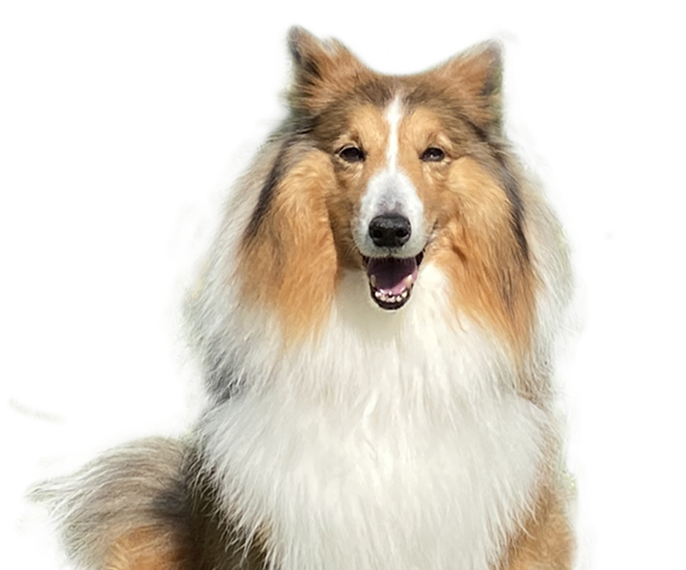
A Doggie Day
2
3-5 times
meals
Urinating
1.5L
1-2 times
water
Pooping
30 mins
Anytime
exercise
Cuddling

